Slide 1
Processor Architecture
SMS implementation
Processor design team
ECE 554, Fall 2002

Slide 2
Processor Architecture Overview
z80 compatible
  Emulates all architectural states
  Timing is not emulated
RISC implementation
  Single-issue pipelined core
  Load / Store architecture
Translating z80 instructions into micro-ops
  Reducing the complexity of the pipelined implementation of z80

Slide 3
Processor Architecture Overview
memory interface
Memory arbitration
& paging monitor
z80
fetch
xlate
decode
/
RF
access
ALU
stage
Mem
access
instruction
queue
fetch / translator
RISC core

Slide 4
Memory interface
Interface between FPGA memory and the processor
The processor interface follows z80 specifications
16-bit address, 8-bit data bus
requires arbitration between instruction fetcher and memory access stage in the core
monitors a write operation w/ memory paging

Slide 5
Instruction fetch / translation
z80 instruction fetcher
translator
pre-decode
logic
z80 I ready
pre-decode info
memory
system
xlator stall
z80
inst queue
8-bit
z80
inst word
16-bit
addr
fetch
PC
1
1~4 byte
z80 I-word
adder
target PC (from the core)
MUX
taken CTI/interrupt
(from the core)

Slide 6
Instruction fetch / translation
z80 → micro-op translator
z80
fetcher
z80 I ready
xlator
uop[0]
Inst
queue
pre-decode info
uop[1]
uop[2]
xlator stall
uop[3]
queue full
1~4 byte
z80 I-word
  reads 1~4-byte z80 I-word at once
  pre-decode information is used to translate z80 instructions
  generates up to 12 (hopefully) cracked micro-ops, sending up to 4 micro-ops to the instruction queue at a clock cycle

Slide 7
RISC core
Decode
Inst
queue
pipeline
control block
control signals
micro-op word
nextPC disp
Flag annotation
EOI annotation
PC
(architected)
controls interrupt
adder
target PC
MUX
taken CTI/interrupt
to z80 fetcher
  micro-op word: translated instruction word
  nextPC_disp: displacement from PC to the next sequential PC
  Flag annotation: determines which bits in F register will be updated with the condition code generated by ALU operations
  EOI: end of (translated) instructions: interrupt can occur after this instruction

Slide 8
Maintaining z80 architectural states
Register value
  maintaining reg value states is straight-forward
  translated ALU / load operations update RF
Memory value
  store (u-op) updates the contents of memory
  problem: external paging by memory module
    when the processor updates the content of 0xFFF?, the memory interface changes the page accordingly
    In our processor, translated instructions that follow a store w/ this paging semantic should be invalidated since the instructions came from the old page
    the memory interface checks if a write operation incurs memory paging
    Flush the pipeline and fetching from the new page

Slide 9
Maintaining z80 architectural states
Condition codes
which bits in F
will be masked?
(mask annotation)
Is this instruction
update F register?
(flag annotation)
ALU
result
F reg
in RF
condition codes (SZCHPN)
  Originally, condition code is a byproduct of ALU operations, generated per instruction-basis
  Micro-ops perform intermediate ALU operations that potentially change the condition code state (F register)
  Annotation bits control 1) updates to F register 2) bits to be masked (not affected)
  Some condition bits should be explicitly set by a sequence of instructions

Slide 10
Maintaining z80 architectural states
Control flow
  Fetcher / translator assume that the control flow does not change
  When a translated CTI incurs a control transfer, squash all instructions behind (core pipeline, xlator, fetcher)
  update the fetchPC and PC(architected) pointing to the targetPC
  future improvement
    detecting unconditional CTIs at fetch
    ***R (repeat) instructions: memory compare/copy insts
    requires adding a prediction bit (taken / untaken) as an annotation

Slide 11
Maintaining z80 architectural states
z80 interrupt
  interrupt can occur only at z80 instruction boundary
  EOI (end of instructions) specifies the end of a translation group
  the handler holds the incoming interrupt and waits until:
    an instruction w/ EOI in decode/RF stage
    a control transfer occurs
  squash all instructions behind, put the content of PC into the stack (memory location pointed by SP), update fetchPC and archPC to the trap location
    the translator can take care of these operations if implementing this operation in the control logic is not feasible
  RETI or RETN (return from interrupt) z80 instructions transfer the control back to the original location (implemented by micro-ops)

Slide 12
RISC core
Register file access
5
RF
16
Rd 0
Rd_data 0
5
16
Rd 1
Rd_data 1
5
Wr
Wr_data
16
Wr F
Wr F
8
?
F mask
  28-entry RF (non-standard), 2 reads, 1 write, 1 F-reg write
  F_mask is used to implement “??? flag is not affected”
  8 / 16 register pair realized in HW
  internal bypass path (handling RAW in the same clk cycle)

Slide 13
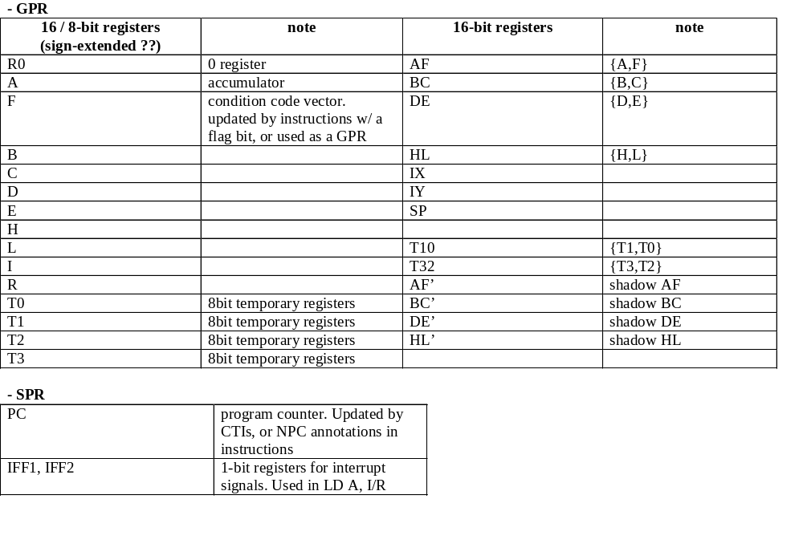
Registers

Slide 14
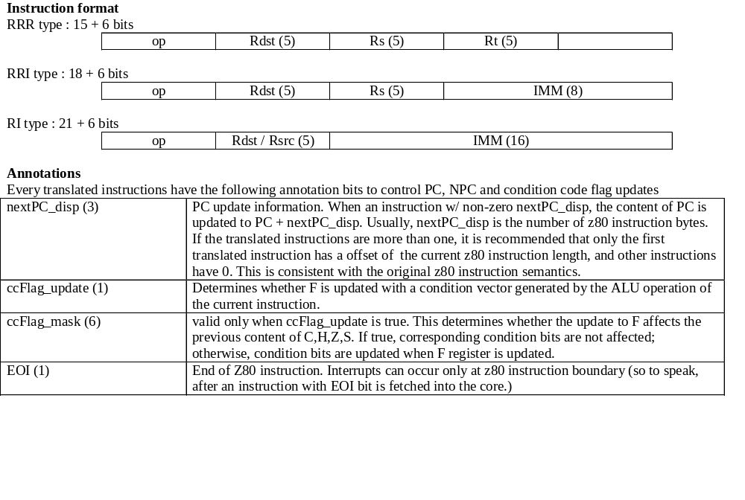
Micro-op format

Slide 15
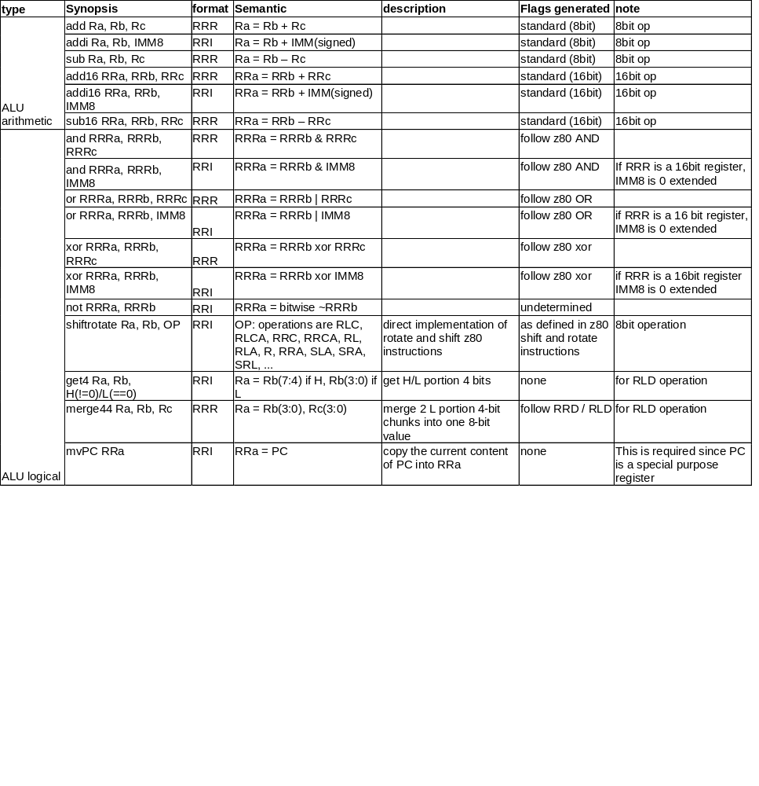
Micro ISA – ALU operations

Slide 16
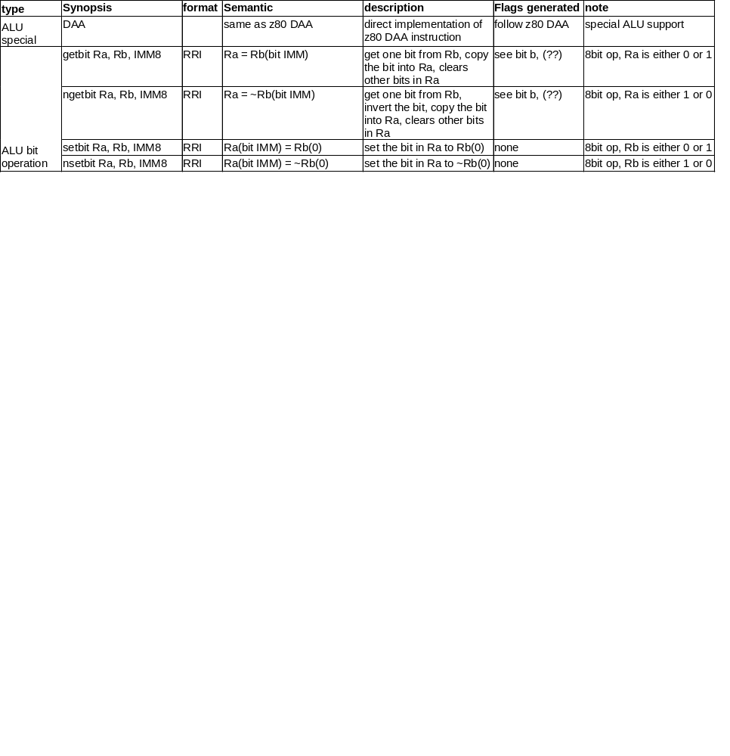
Micro ISA – ALU operations

Slide 17
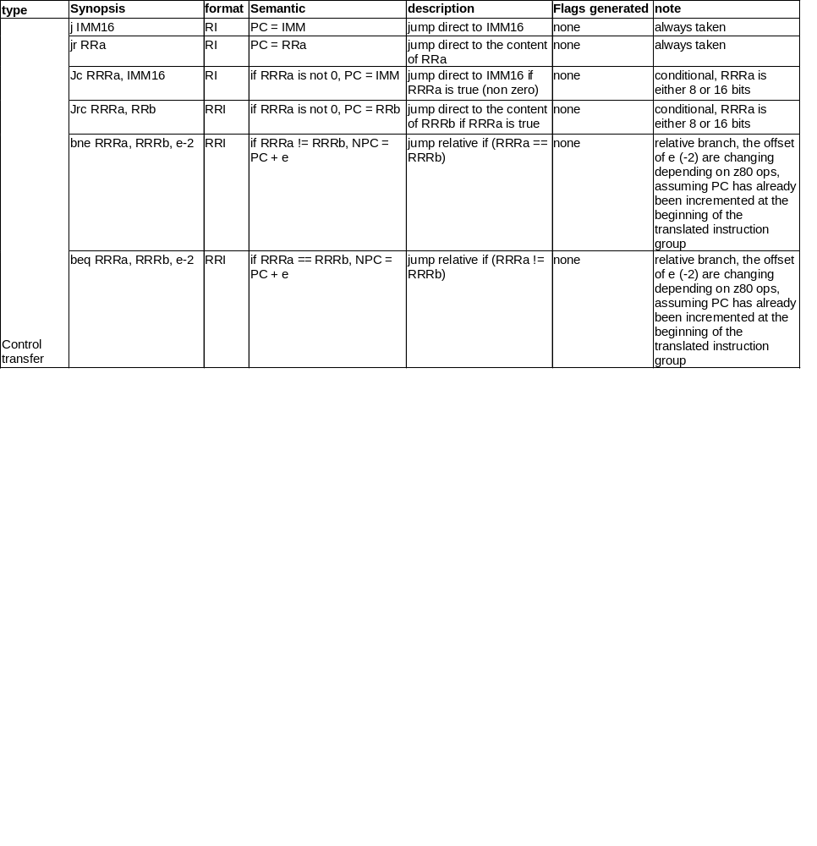
Micro ISA – Control transfer operations

Slide 18
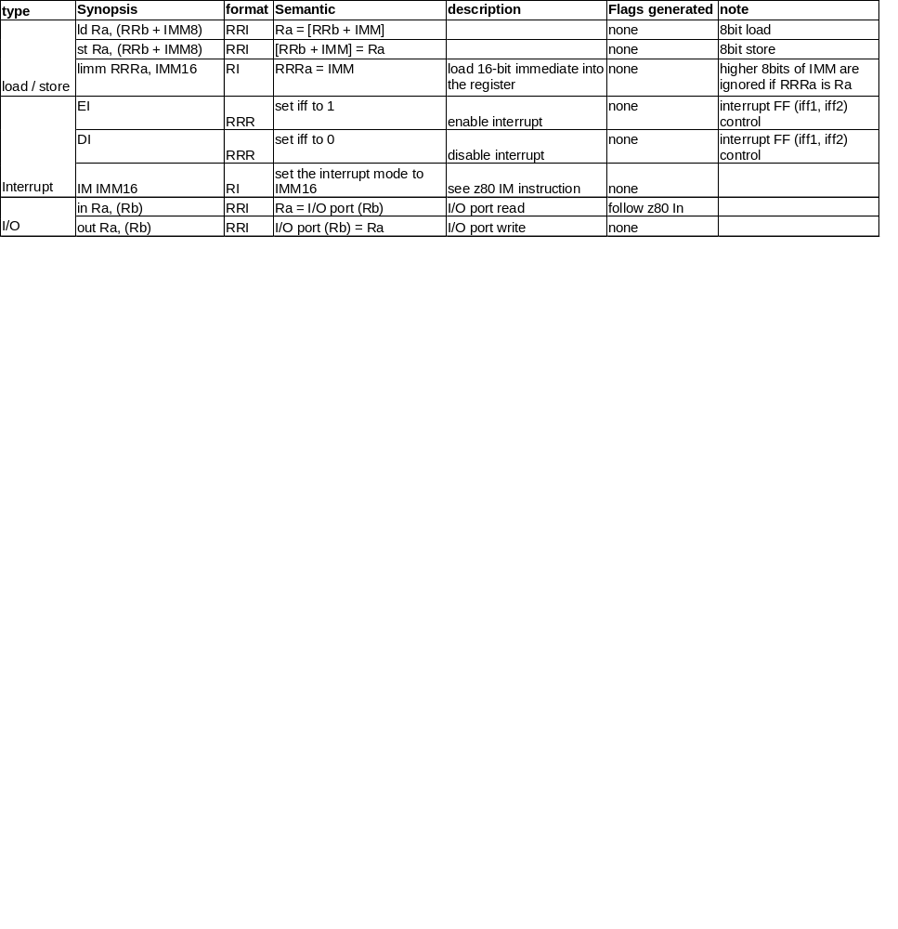
Micro ISA – Mem / interrupt / IO

Slide 19
Translation example
CPDR z80 instruction (2 bytes)
  A-(HL), HL ← HL-1, BC ← BC-1
  and repeat until A == (HL) or BC == 0
  Condition bits affected:
    S set if result is negative
    Z set if A == (HL)
    H set if borrow from bit 4
    P/V set if BC –1 != 0
    N is set
    C is not affected
x1 nextPC_disp 2 | x2 | x3 ccFlag_update (mask C) | x4
ld temp0, (HL) | addi16 HL, HL, -1 | addi16 BC, BC, -1 | getbit temp1, F, pos_Z
x5 ccFlag_update (mask C) | x6 | x7 | x8 EOI
sub temp0, A, temp0 | nsetbit F, temp1, pos_P/V | bne A, r0, -2 | bne BC, r0, -2

Slide 20
Back-up slides

Slide 21
Instruction fetch / translation
Instruction queue
uop[0]
xlator
FIFO queue0 (core gen)
decode
RF
uop[1]
FIFO queue1 (core gen)
uop
uop[2]
MUX
FIFO queue2 (core gen)
uop[3]
FIFO queue3 (core gen)
queue full
sequencing 0,1,2,3
  Multi-input, single-output FIFO
  queue 4 uops in parallel (if less than 4, put nop)
  dequeue 1 uop sequentially from each queue
  When instruction w/ EOI (end of instructions) annotation is dequeued, also dequeue nops and start dequeueing from queue0

Slide 22
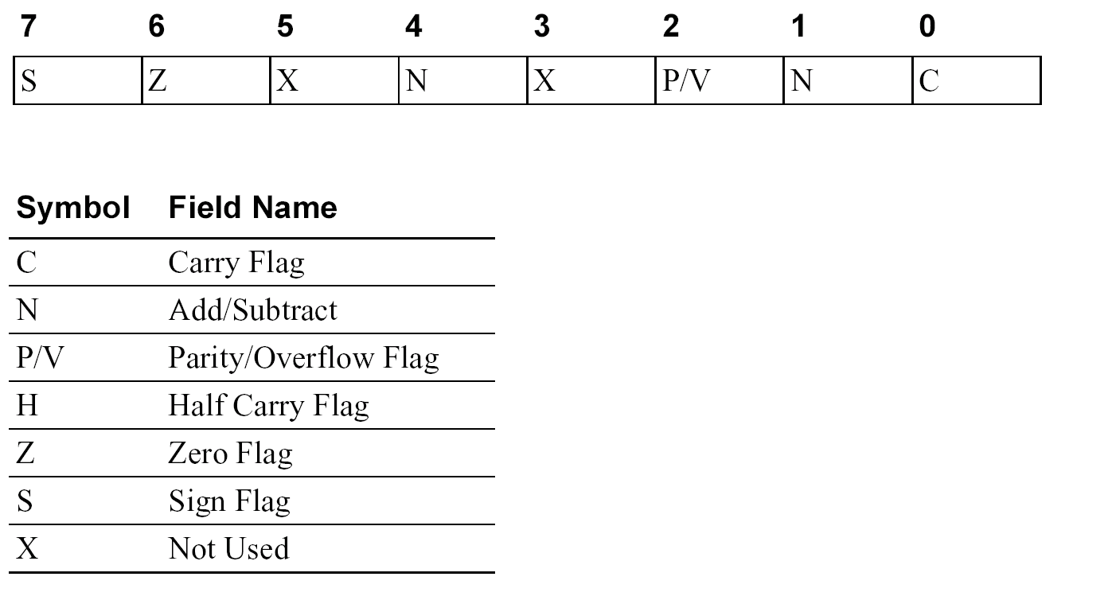
z80 Flags (F and F’)

Slide 23
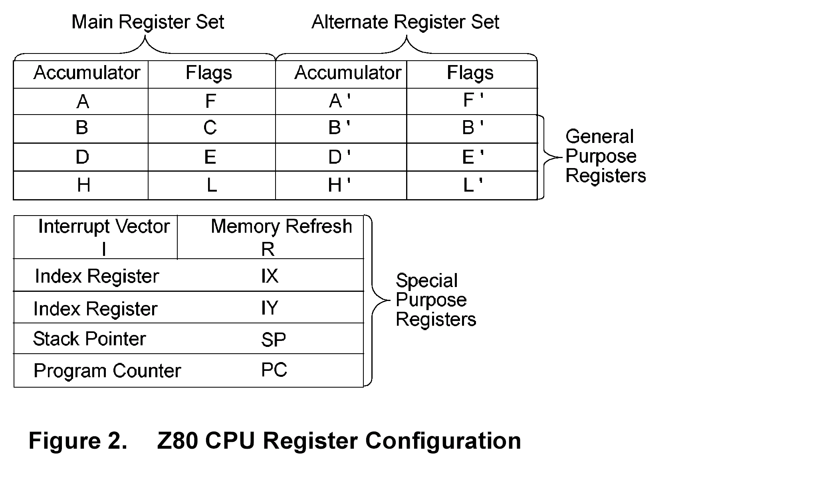
z80 registers

Slide 24
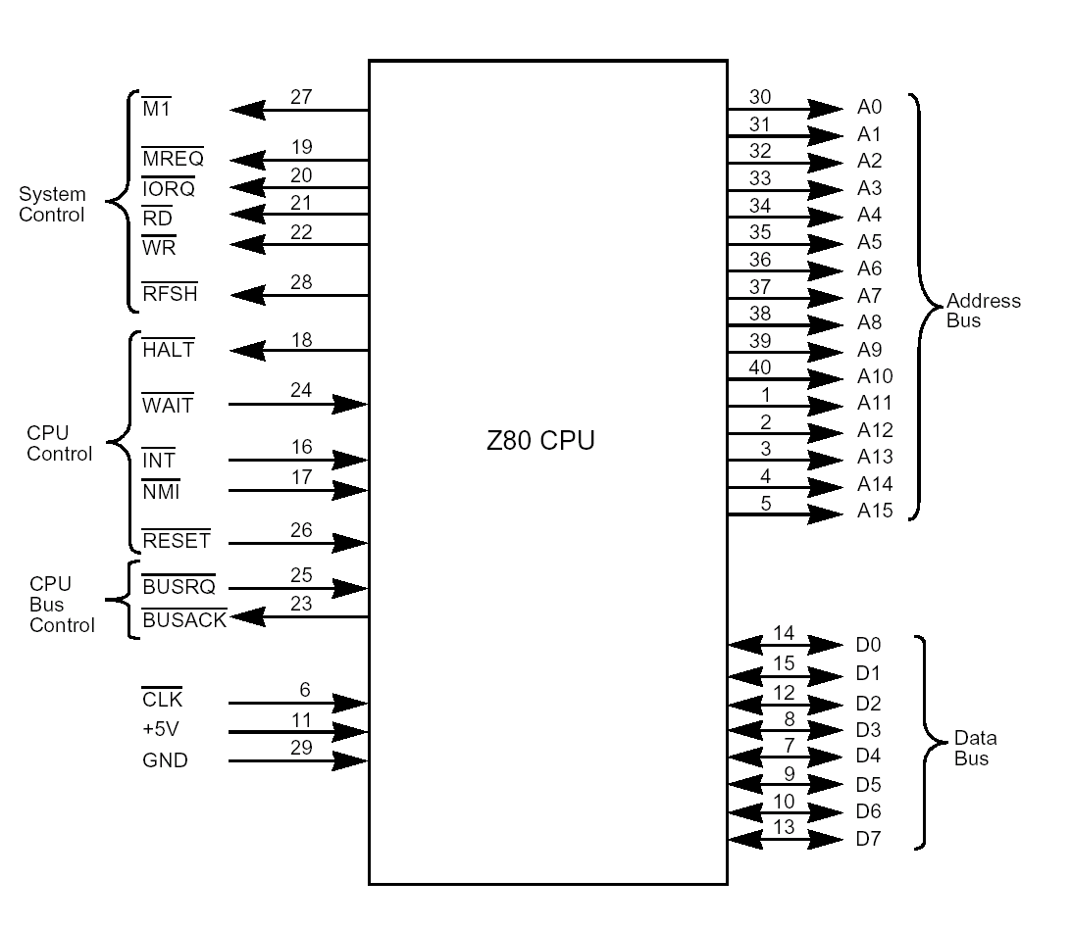
z80 pins

Slide 25
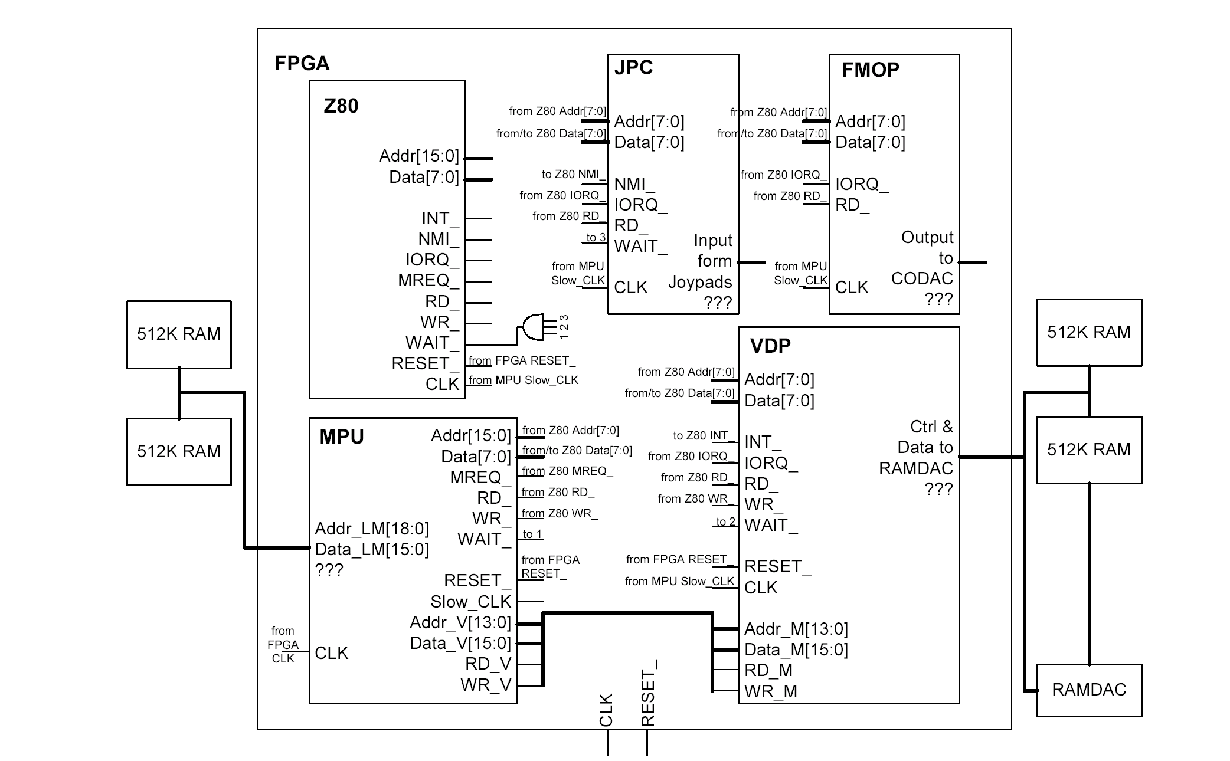
SMS system

Slide 26
RRR
38
36
35
28
27
26
21
20
16
15
11
10
6
5
0
PC_disp
(3)
F_mask(8)
EOI
(1)
OP (6)
Rd(5)
Rs(5)
Rt(5)
RRI
38
36
35
28
27
26
21
20
16
15
11
10
8
7
0
PC_disp
(3)
F_mask(8)
EOI
(1)
OP (6)
Rd(5)
Rs(5)
IMM(8)
RI
38
36
35
28
27
26
21
20
16
15
0
PC_disp
(3)
F_mask(8)
EOI
(1)
OP (6)
Rd(5)
IMM(16)

